Slide 1
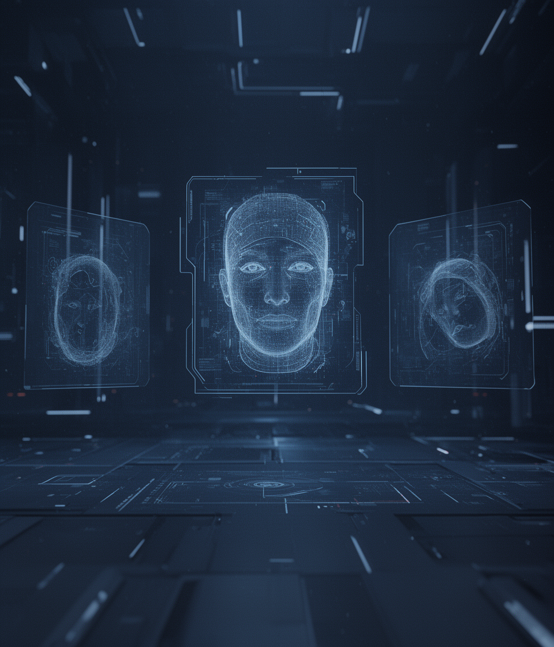

Face Recognition and Deep Fake detection

Slide 2
Team Members
K . Harsha Vardhan - 22BTRCL075
M . Sai Shreyas Reddy - 22BTRCL094
CV . Bhargav Gowd - 22BTRCL043
CH . Madhu keerthi - 22BTRCL038

Slide 3
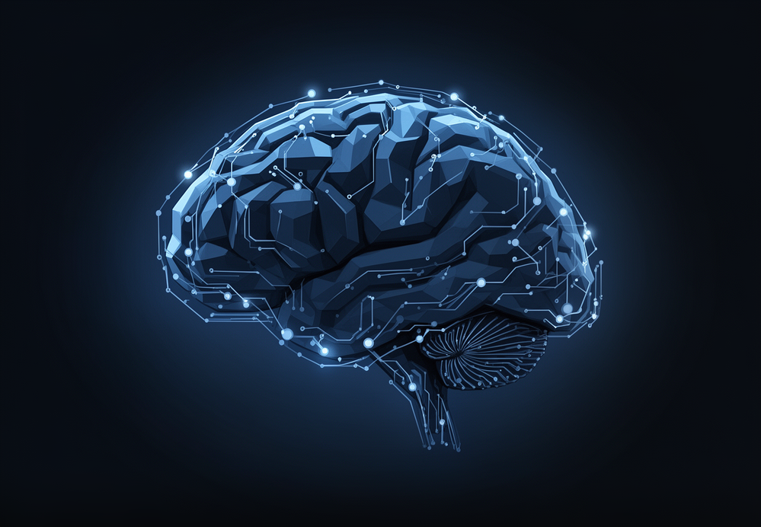
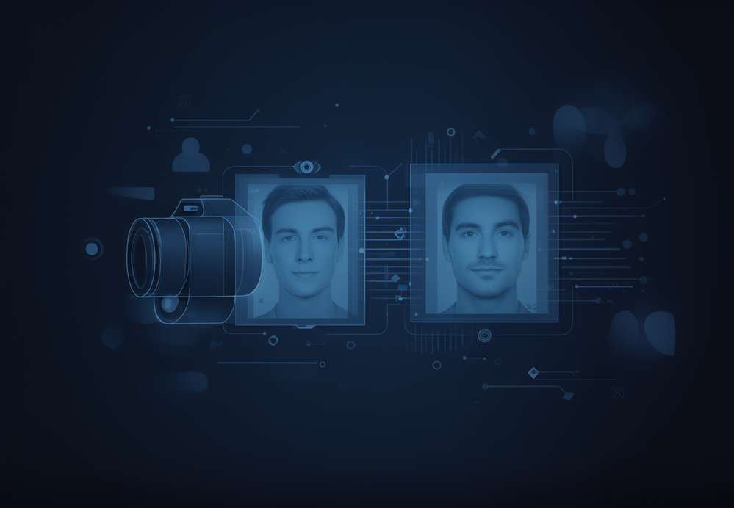
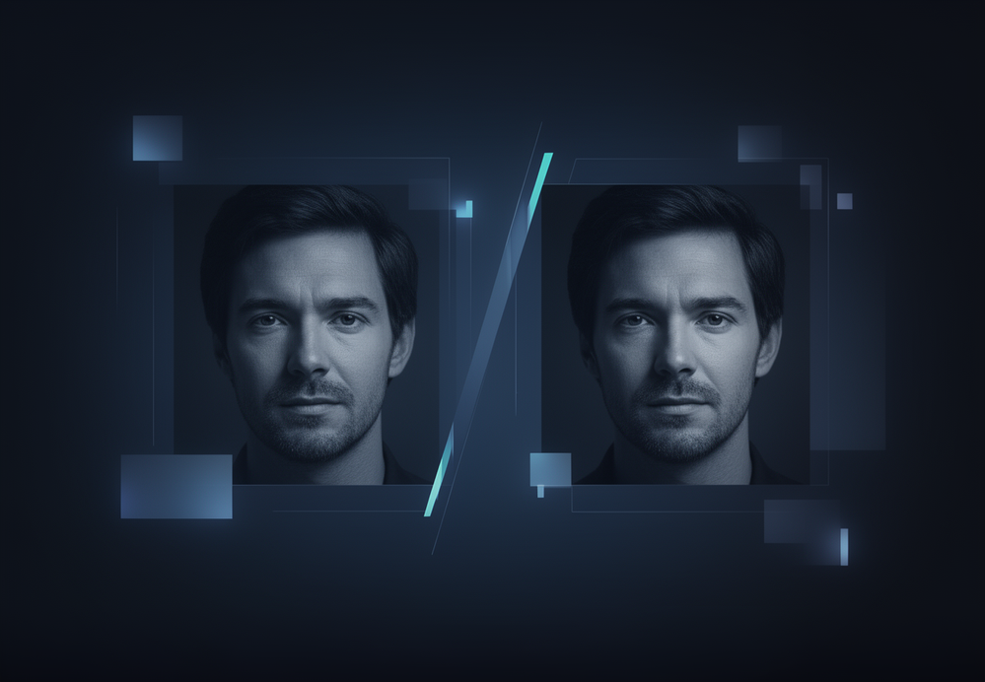
Detecting faces with advanced AI technology
Recognizing individuals accurately and efficiently
Identifying deepfakes to ensure security

Slide 4

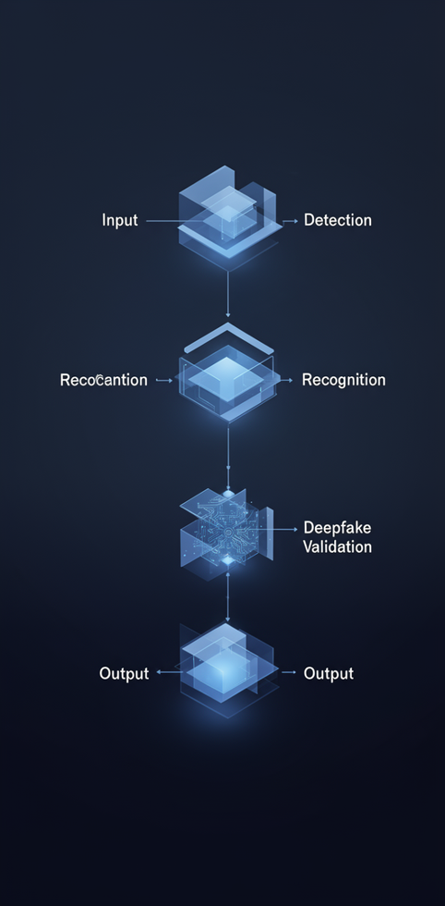
System Process Overview
This system seamlessly integrates input, detection, recognition, and deepfake validation processes, ensuring efficient analysis and output of face recognition results in real-time.

Slide 5
Key Technologies for Detection System
Python
OpenCV
Python is a versatile programming language known for its simplicity and extensive libraries, ideal for AI applications.
OpenCV is an open-source computer vision library that provides tools for image processing and real-time video analysis.
TensorFlow
MTCNN
TensorFlow is a powerful open-source machine learning framework that enables the development of deep learning models efficiently.
MTCNN (Multi-task Cascaded Convolutional Networks) effectively detects faces in images, crucial for our recognition system's accuracy.

Slide 6
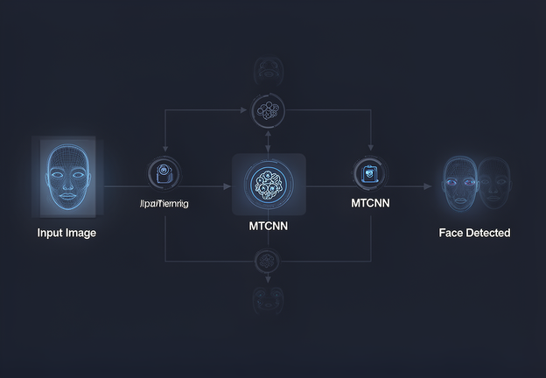
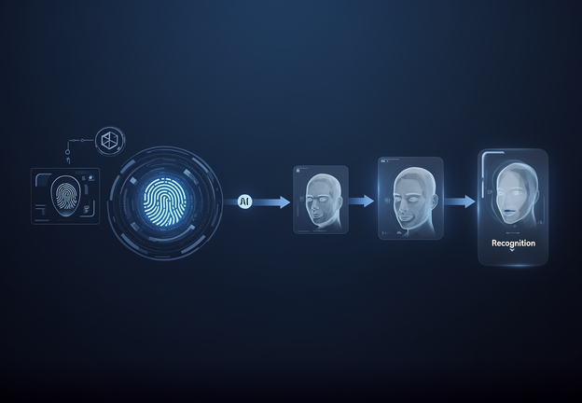
Architecture Flow Diagram
Detection
This phase identifies faces in images for further processing.
Recognition
This step matches detected faces against stored data for identification.

Slide 7


Deepfake Check and Output
Deepfake Check
The system analyzes input for signs of manipulation.
Result Visualization
Outputs are displayed with color-coded results for clarity.

Slide 8
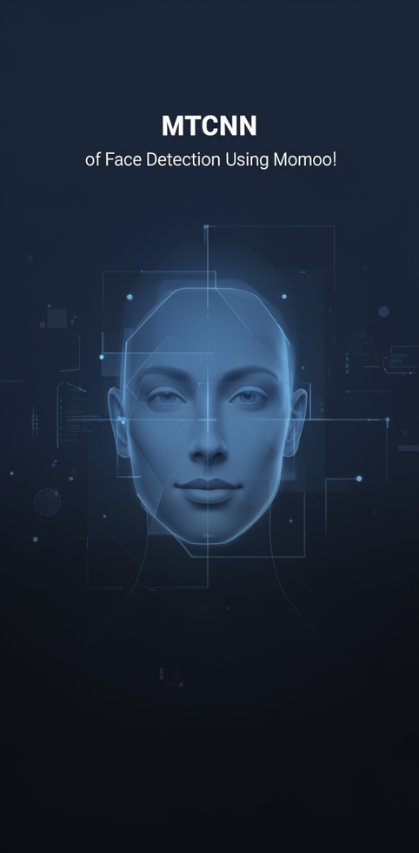
FACE DETECTION
MTCNN Overview
MTCNN, or Multi-task Cascaded Convolutional Networks, efficiently detects faces by extracting features and applying deep learning techniques for accurate and rapid identification.

Slide 9

FACE RECOGNITION
Embeddings and Threshold
Face recognition relies on embeddings to convert images into vectors, enabling comparison against stored data. A defined threshold determines matches effectively and accurately.

Slide 10

Features-Based Detection
Features Used in Our System
1. Image Sharpness (Laplacian Variance) 2. Face Symmetry 3. Skin Texture Consistency 4. Edge Density

Slide 11
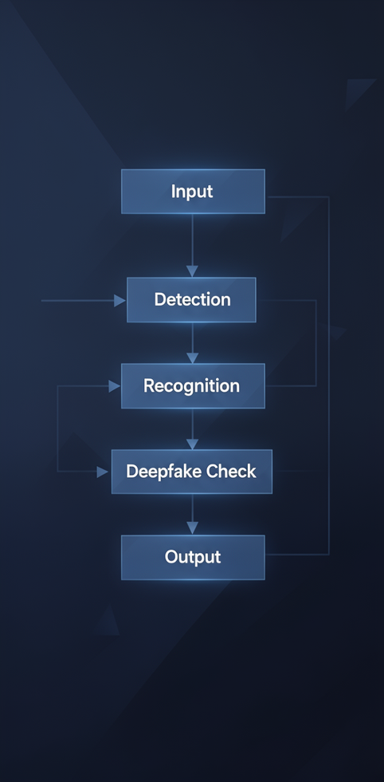
System Process Overview
This section outlines the step-by-step process of our face recognition and deepfake detection system, emphasizing smooth transitions and real-time analysis for enhanced security.

Slide 12
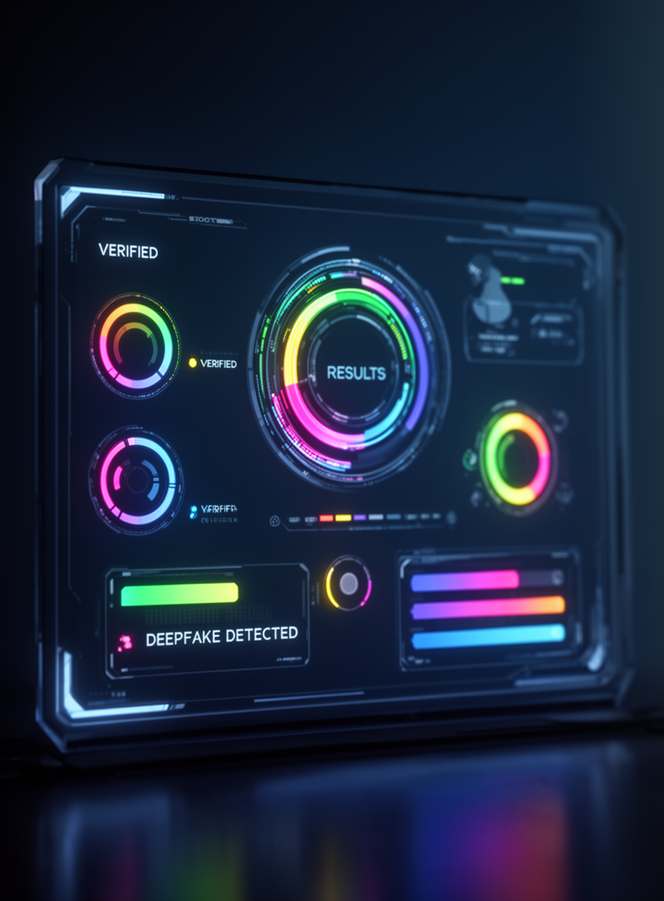
Output Results
This section presents the color-coded results from our face recognition and deepfake detection system, illustrating the effectiveness and reliability of the implemented algorithms in real-time scenarios.

Slide 13

Conclusion & Future
In conclusion, the Face Recognition with Deepfake Detection System promises enhanced security and real-time analysis, paving the way for future advancements in AI technology and face recognition.

Slide 14
Thank you!
For inquiries, contact us at hello@reallygreatsite.com or visit our website.

